Slide 1
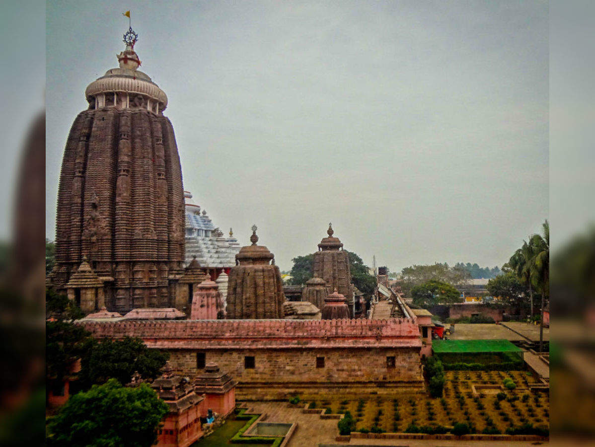
This mystical place,
Also called The land of God,
Famous for innumerable things,
Is no other state but
Orissa

Slide 2
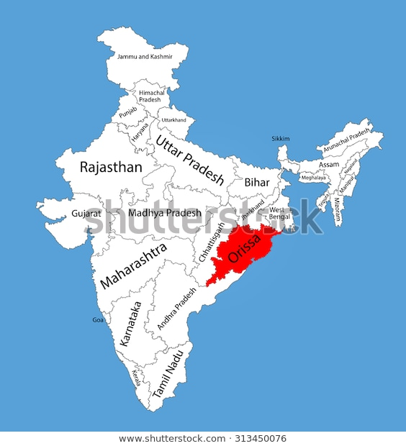
Introduction- Odisha, formerly called Orissa, state of India. Located in the northeastern part of the country, it is bounded by the states of Jharkhand and West Bengal to the north and northeast, by the Bay of Bengal to the east, and by the states of Andhra Pradesh and Telangana to the south and Chattishgarh to the west. Before India became independent in 1947, Odisha’s capital was at Cuttak. The present capital was subsequently built at Bhubaneshwar, in the vicinity of the city’s historic temples in the east-central coastal plains. In late 2011 the state’s name was officially changed from Orissa to Odisha. Area 60,119 square miles (155,707 square km).

Slide 3
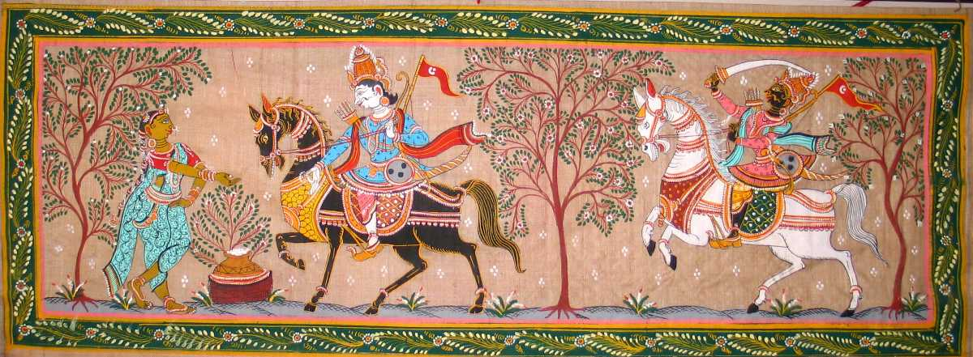
So,lets first see the famous culture and heritage of Orissa…..
Arts Culture of Odisha
Pattachitra (Cloth Painting)
Literally, 'Patta' translates to cloth and 'Chitra' means picture. The themes and motifs are mythological, typically revolving around the Jagannath and Vaishnava sect. Lord Jagannath and Radha-Krishna paintings are a rage among buyers. Pattachitra showing Ganesha and Shiva. Since it is a traditional art-form, the Chitrakara's (painter) very home is his own studio where his family members act as helping hands. The final painting is rendered in the form of a design on a canvas with decorative borders. Sometimes, palm-leaves are also used to form the canvas.

Slide 4
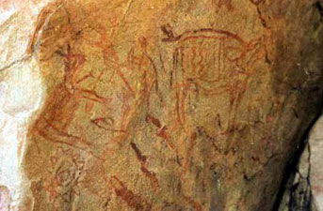
Rock paintings..
Rock art in Odisha dates back to the prehistoric period according to the earliest reports found at Viramkhol in Jharsuguda district. With the reign of Ashoka the great, Buddhist sculptural art gradually changed the degree of Odisha's artistic flair. Even today, the caves of Ratnagiri, Lalitgiri and Udaygiri have not faltered to showcase the wonderful legacy of sculptural brilliance that some of our finest carvers left behind.

Slide 5
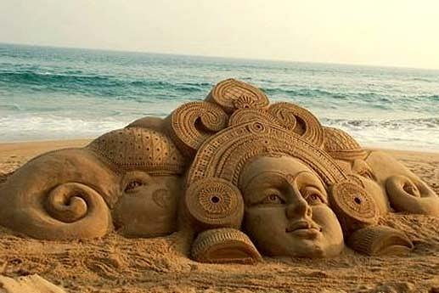
Sand Art
With clean, fine-grained sand and water as its raw materials, this is an indigenous form of art that found its origin recently if a comparison is drawn to the other forms of art. It is practised on the beaches of Puri with subjects ranging from Hindu deities to international occasions. With the help of tourism, this art-form has developed exponentially and found worldwide recognition.

Slide 6

Dance
Originally performed by Devadasis, Odissi bears the closest resemblance to temple culture than any other existing form of dance. It traditionally depicts the divine love between Lord Krishna and his consort Radha, drawing inspirations from the lyrical compositions of poet Jayadeva. The dance basically involves a mythical story, symbolic costumes, abhinaya (expressions), mudras (gestures) and is extremely graceful.

Slide 7
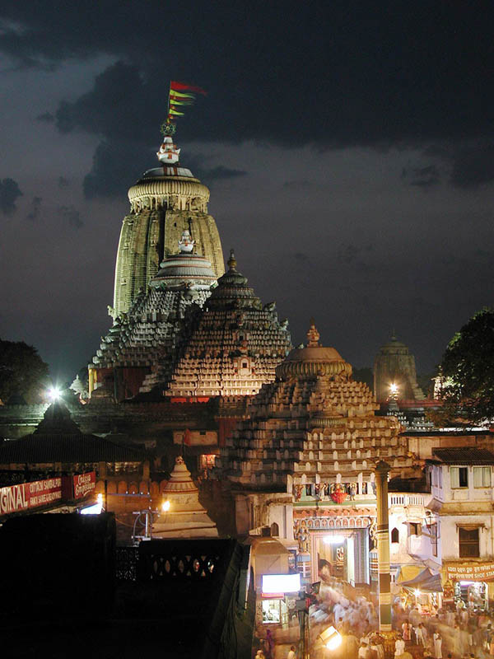
Jagannath Temple
The Shree Jagannath Temple is an important Hindu temple dedicated to Jagannath, a form of Vishnu, in Puri in the state of Odisha on the eastern coast of India. The present temple was rebuilt from the 10th century onwards, on the site of an earlier temple, and begun by King Anantavarman Chodaganga Deva, first of the Eastern Ganga dynasty.
The Puri temple is famous for its annual Ratha yatra, or chariot festival, in which the three principal deities are pulled on huge and elaborately decorated temple cars. These gave their name to the English term 'Juggernaut'. Unlike the stone and metal icons found in most Hindu temples, the image of Jagannath is made of wood and is ceremoniously replaced every twelve or nineteen years by an exact replica. It is one of the Char Dham.

Slide 8
Now,shall we talk about history of Orissa? Let’s begin…
1)Odisha has a rich history which dates back to the time of Kalinga war .It is that land which made the transformation of Asoka from Chandasoka to Dharmasoka.
2)261 BC - Kalinga war . It was fought between Asoka samrat and the Kalinga warriors. Though it was not clear who ruled Odisha at that time but that war is one of the most famous battles ever fought in the world. With this the Mauruas ruled Odisha for nearly 200 years till 1st century BC.
3)1st Century BC - In that period Kalinga was out of the Maurya kingdom and it was ruled by Chhadis. In 49BC Kharavela came to power and as it is known in that time the Kalinga empire spanned from Ganga to Godavari at that time.
4)2nd Century AD- Kalinga was acquired by Satabahana and it remained under their rule till 202 AD. After that it fell into different empires before it was invaded by Guptas.
5)350 - Samudragupta invaded and conquered most parts of Odisha and then Guptas ruled for some years.
6)6-7 century - Sailabhava dynasty started ruling in the coastal Odisha. It is believed that the trades flourished in that period . The sadhaba pua of Odisha used to travel far locations to trade. In 621 AD Harsha vardhan acquired some parts of Odisha. Chinese traveler Hiuen Tsang visited Odisha in the 630 AD.

Slide 9
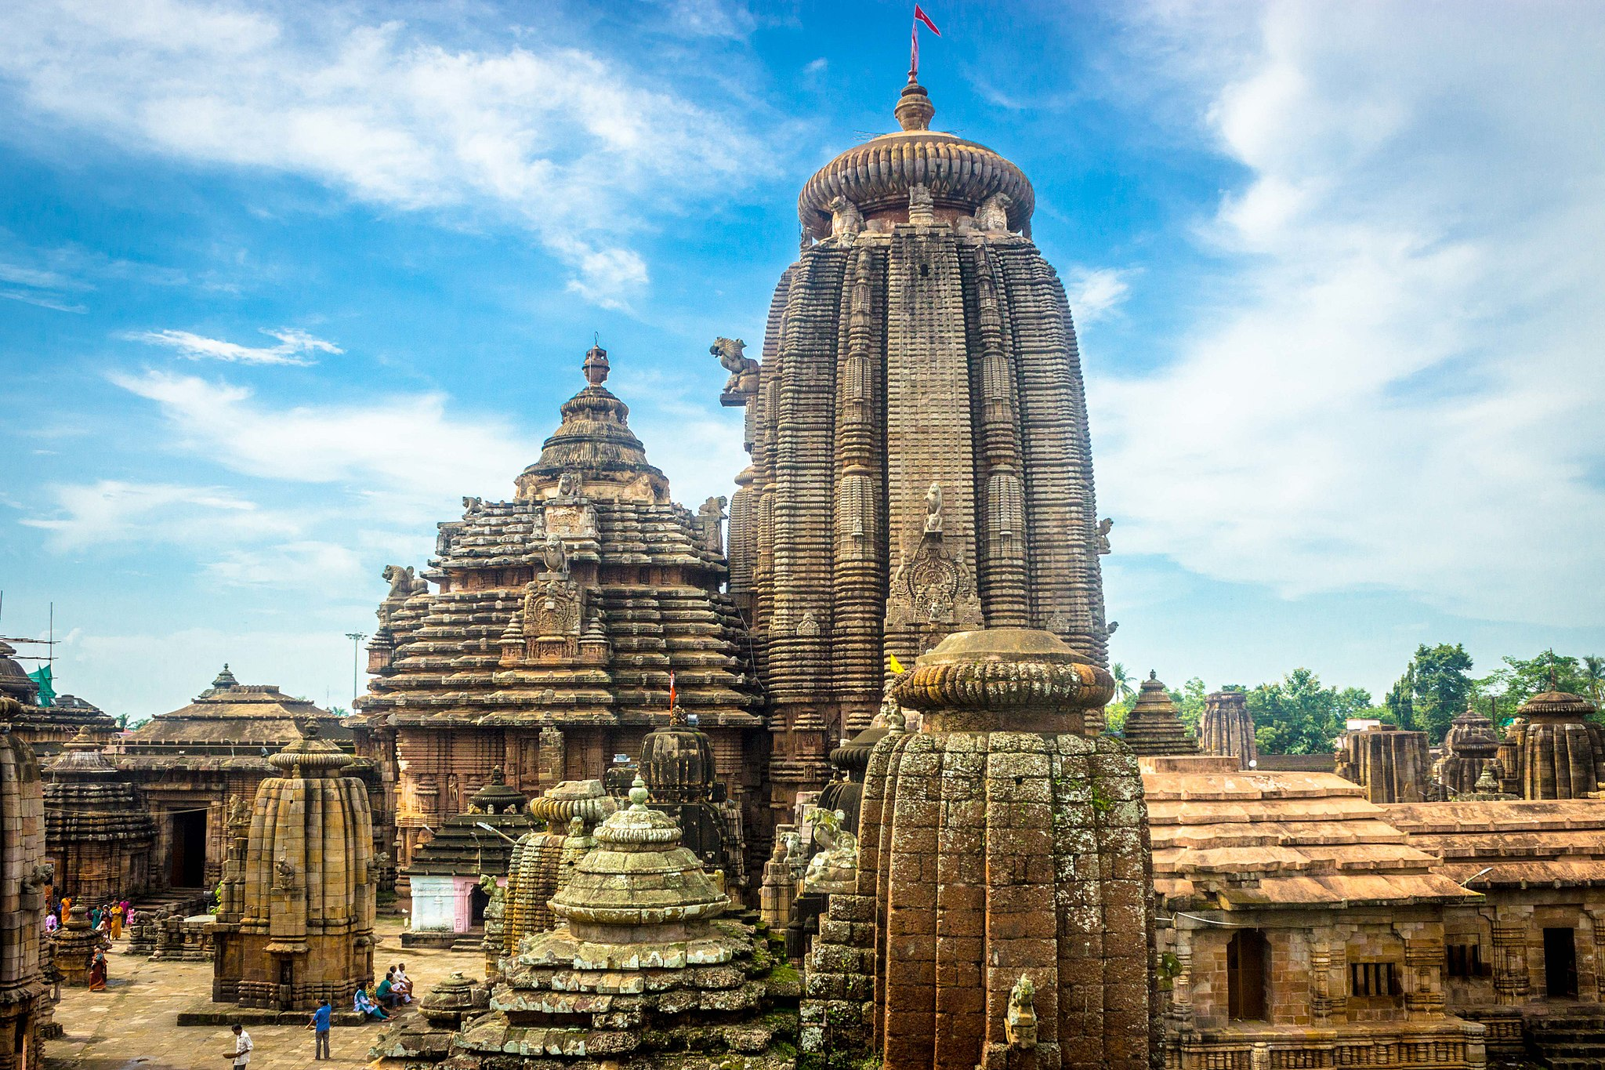
7)1038 - Gangas started to rule Odisha. They are the people who built many temples and monuments including the world famous Jagannath and Konark sun temple. 8)1112 - Choda Ganga Dev became the king.He built the famous Jagannath temple. 9)1238- Narasimha Dev came to power , who later on built the sun temple at Konark. 10)1361- Firoz Shah Tuglaq invaded Odisha and acquired Vidanasi Katak(Cuttack). 11)After that for some time Odisha was the battle ground between Afghans and Mughals. 12)1568-Mukunda Dev , the last independent ruler of Odisha was dethroned. 13)After that Odisha was ruled by Mughals and for some year it was under the Maratha empire. 14)1803-Odisha was the last independent state to be included in the British empire. 15)1866- The infamous Na-anka famine that killed almost a million people of Odisha. 16)1936- Odisha became the first state to be built on the basis of language. 17)1942-Eram massacre by the British .

Slide 10
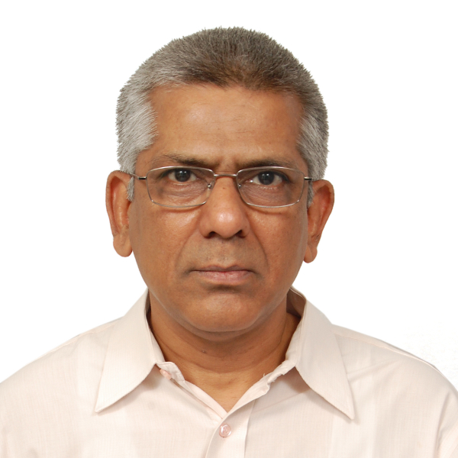
Hmm…Now let’s acknowledge ourselves
About scientific side orissa
Let’s dive in!
One of the famous mathematicians of orissa is-
Gadadhar Misra , He was born at Bhubaneswar in the state of Odisha to Prof Chakrapani Mishra and Smt Arunabala Mishra. He studied at DM School, BJB College, Sambalpur University (Masters, 1979) and State University of New York in USA (PhD, 1982). He taught at Indian Statistical Institute (ISI), Kolkata and Bengaluru before joining the Indian Institute of Science (IISc), Bengaluru where he is currently engaged in teaching and research.
He was awarded the, Shanti Swarup Bhatnagar Prize for Science and Technology in 2001, the highest science award
In India.

Slide 11
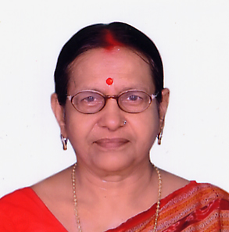
Another mathematician of Orissa Indulata L. Sukla
Indulata L. Sukla (born March 7, 1944) is a former Professor of Mathematics, who served for more than three decades at Sambalpur University, Sambalpur, Odisha, India.
She did her schooling from Maharani Prem Kumari Girls’ School and B.Sc. with Mathematics Honours from M.P.C. College, Baripada. She completed her M.Sc. in Mathematics from Ravenshaw College, Cuttack in 1966, and had a brief stint as a lecturer in M.P.C. College, before moving to the University of Jabalpur with a CSIR Fellowship to pursue Ph.D under the supervision of Tribikram Pati. While pursuing her researches, she joined Sambalpur University in November 1970 as a lecturer in the School of Mathematical Sciences, and continued there till her retirement in March 2004.
She is the author of the textbook Number Theory and Its Applications to Cryptography (Cuttack: Kalyani Publishers, 2000). In her research, she worked with English mathematician Brian Kuttner on Fourier Series. She is a Life Member of the American Mathematical Society (AMS) and the Indian Mathematical Society (IMS).
Awards and honours
The Orissa Mathematical Society (OMS) gave her the Lifetime Achievement Award for her work in Number Theory, Cryptography and Analysis. She received the award from Professor Ramachandran Balasubramanian, Director of the Institute of Mathematical Sciences, Chennai at the 42nd Annual Conference of OMS held at Vyasanagar Autonomous College, Jajpur Road, Orissa on February 7, 2015.

Slide 12
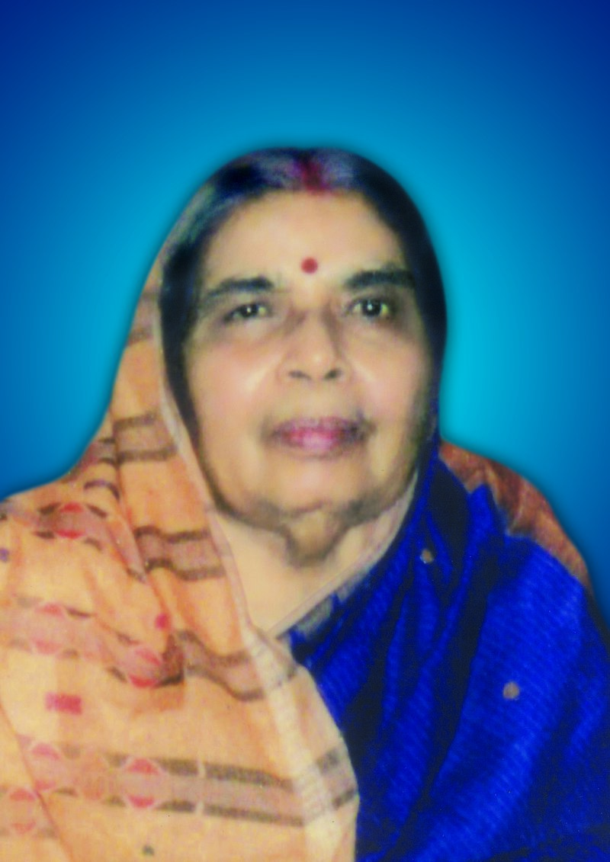
Frist female scientist of Orissa…
Sudhira Das ( 8 March 1932 – 30 October 2015) was an Indian engineer. She was the first female engineer from the state of Odisha. She became an engineer at a time when education was a taboo for women in India.
After graduating with her MSc. (Tech), Das started teaching at the Berhampur Engineering School (currently Uma Charan Pattnaik Engineering School) as a lecturer in the department of Mathematics in 1957. Later she became the principal of Women’s Polytechnic, Rourkela. During 1957-1990, she served the Government of Odisha in various different capacities. During that period she founded Women’s Polytechnic, Bhubaneswar, an institutions providing diploma programs to female students which has been one of her major contributions.

Slide 13
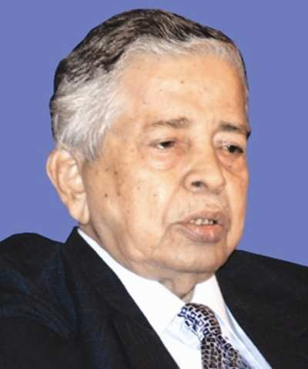
Gokulananda Mahapatra
Gokulananda Mahapatra (24 May 1922 – 10 July 2013) was an Indian scientist and science fiction writer, who popularized science in the Odia language. Mahapatra has authored over 95 science fiction and children science books. Some of his notable contributions are Krutrima Upagraha, Prithibi bahare Manisha, Chandra ra Mrutyu, Nishabda Godhuli, Madam Curie and Nila Chakra Bala Sapare. He was the founding member of Orissa Bigyana Prachar Samhiti with the objective of making science popular in the state of Orissa. He received Orissa Sahitya Akademy Award for his book E juga ra sreshtha abiskara.

Slide 14
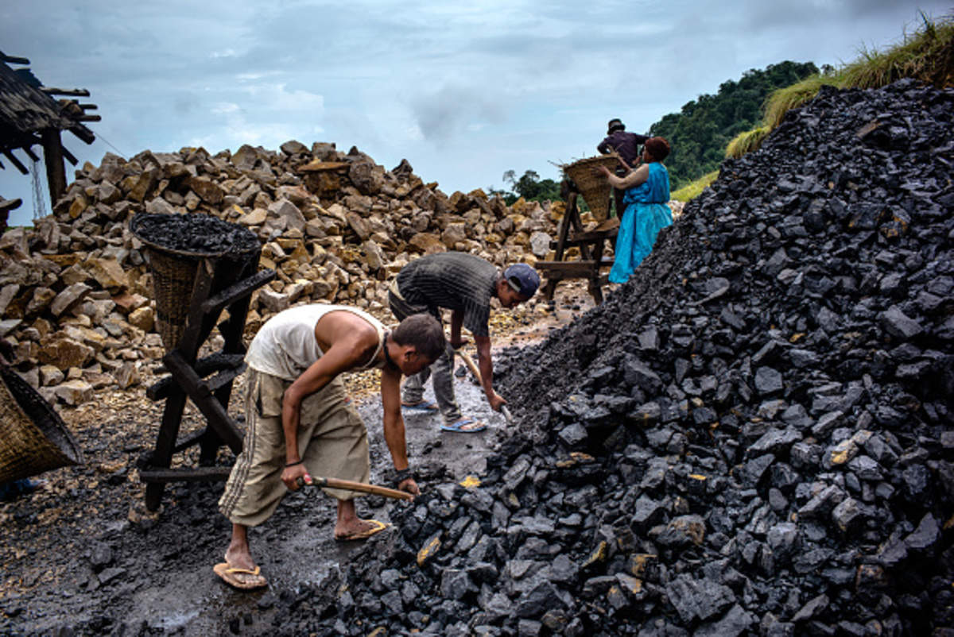
Now let’s see some of the economical activities of Orissa...
In coal and mining-
According to Geological Survey of India, the Talcher Coalfield has reserves of 51 billion tonnes, the highest in India.
Talcher Coalfield covers an area of 500 km² (190 sq miles). The coal is of lower grade containing only about 35 per cent of fixed carbon, 70 per cent volatile matter and 25 per cent ash content. As of 2011, nearly one hundred thousand tonnes of coal is dispatched daily to power stations in Odisha, Tamil Nadu, Andhra Pradesh, West Bengal and other parts of India.

Slide 15
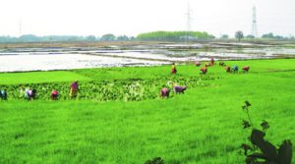
In agriculture-
The climate of the State is tropical, characterized by high temperature, high humidity, medium to high rainfall and mild winters. The normal annual rainfall is 1,451.2 mm of which the South-West monsoon contributes about 80 percent. From the physiographic point of view, the State has been divided into four zones, viz (i) the Northern Plateau, (ii) the Eastern Ghat Zone, (iii) the Central Table Land, and (iv) the Coastal Zone. On the basis of climate, soil, rainfall and topography, the State has been delineated into ten Agro Climatic Zones. The State’s Agriculture Sector frequently suffers from natural calamities like cyclones, droughts and flash floods which substantially affect production and productivity of agriculture.
Agriculture in total contributes 15.4%

Slide 16
Power
Odisha has 9036.36 MW installed capacity of electricity production, out of which 6753.04 MW is coal-generated. 2166.93 MW is generated by hydro power and 116.39 MW by other renewable sources.
Odisha was the first state in India to reform its power sector. In 1996, it passed the Orissa Electricity Reform Act to restructure and privatize the sector. Before the Act, the single public-sector company Orissa State Electricity Board (OSEB) had been producing and supplying electricity in the state since its establishment in 1961. But by 1994–95, OSEB had run into heavy losses and there was a gap of 45% between consumption and production. The reforms unbundled power generation from transmission and distribution. Following the reforms, hydro power plants were handed over to Odisha Hydro Power Corporation (OHPC) and the existing thermal power plants were transferred to Odisha Power Generation Corporation (OPGC). Grid Corporation of Odisha (Gridco) was given the task of power supply. Initially, these were operated as state-owned farms, but later were corporatised.

Slide 17
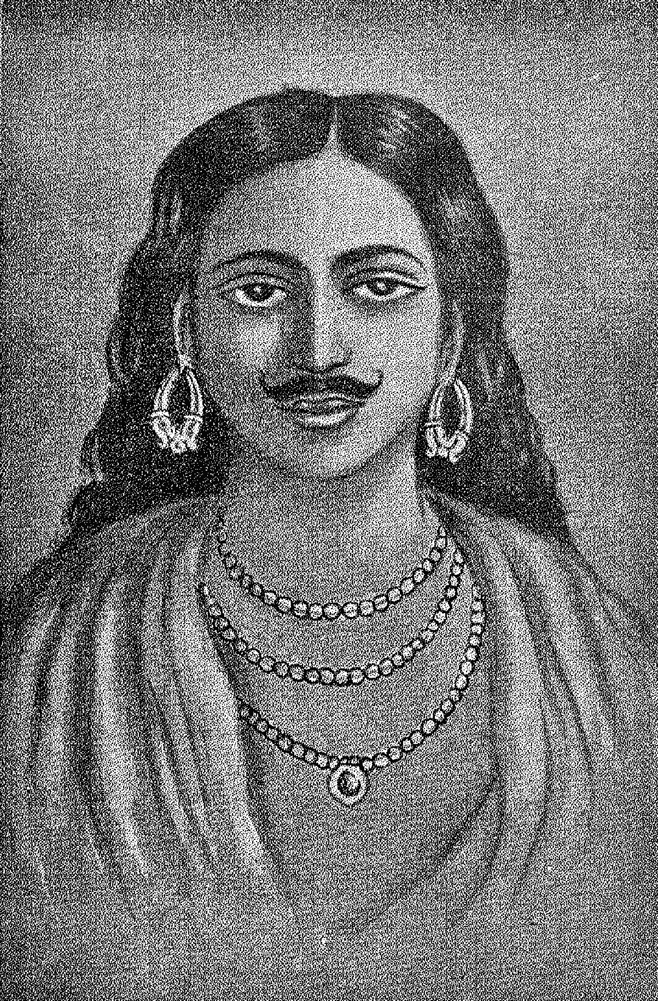
Now,if we notice then Orissa was really famous for literature also right, So, let’s dive in!
Kabi Samrata Upendra Bhanja (born during 1670 (opinions differ between 1670 and 1688) at Kullada , Ghumusara a princely state in Bhanjanagar, 80 km from Berhampur city in south of Odisha and died during 1740 (again opinions differ)) was considered as the greatest poet of Odia Literature and was awarded the title "Kabi-Samrata" (also given as Kabi) – "The Emperor of Poets". Born in a royal family, Upendra Bhanja had never eyed for throne.
Upendra Bhanja wrote some 52 books of which only 20 or 25 are available now. Due to the absence of a printing press, many of the hand-copied books have been lost. Some of his eminent Kavyas are Baideheesha Bilasha (with "Ba" initial for each line), Rasalila, Brajaleela, Subhadra Parinaya(with "Sa" initial for every line), Lavanyabati, Premasudhanidhi, Rasikaharabali, Subhadra-Parinya and Chitrakavya-Bondodhya Labanyabati, Koti Brahmanda Sundari, Kala Koutuka (with "Ka" initial for every line), Satisha bilasa" (with initial 'sa' initials every line), "Damayanti BiLasa" (with 'da' initial each line) and "Padmabati Parinaya" (starts with 'pa') etc.

Slide 18
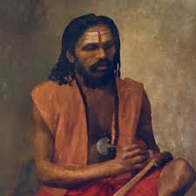
Sarla Das..
Poet Sarla Das's Birth place was Kanakpur Patana ( near Jhankada- Pragana Of Cuttack District). He was an orphan child .So his childhood life was spent with his elder brother.His original name was Sidheswar Parida.After getting the bless of goddess Sarala , Sidheswar was renamed as Sarala Das.
Sarala Dash was written five religious sriptures , such as 1) Chandi Puran 2) Bilanka Ramayan 3) Lakshmi Narayan Bachanika 4) Bichitra Ramayan 5) Maha bharat

Slide 19
Now let’s take a look at literature of orissa in detail....
Odia literature is the literature written in the Odia language and predominantly originates in the Indian state of Odisha. The language is also spoken by minority populations of the neighbouring states of Jharkhand, West Bengal, Chhattisgarh, Karnataka, Andhra Pradesh and Tamil Nadu. The region has been known at different stages of history as Kalinga, Udra, Utkala or Hirakhanda. Odisha was a vast empire in ancient and medieval times, extending from the Ganges in the north to the Godavari in the south. During British rule, however, Odisha lost its political identity and formed parts of the Bengal and Madras Presidencies. The present state of Odisha was formed in 1936. The modern Odia language is formed mostly from Pali words with significant Sanskrit influence. About 28% of modern Odia words have Adivasi origins, and about 2% have Hindustani (Hindi/Urdu), Persian, or Arabic origins. The earliest written texts in the language are about thousand years old. The first Odia newspaper was Utkala Deepika first published on 4 August 1866.
Odia is the only Indo-European language of India other than Sanskrit and the sixth Indian language that has been conferred classical language status and forms the basis of Odissi dance and Odissi music.
Historians have divided the history of the Odia language literature into five main stages: Old Odia (800 AD to 1300 AD), Early Medieval Odia (1300 AD to 1500 AD), Medieval Odia (1500 AD to 1700 AD), Late Medieval Odia (1700 AD to 1850 AD) and Modern Odia (1870 AD to present).

Slide 20
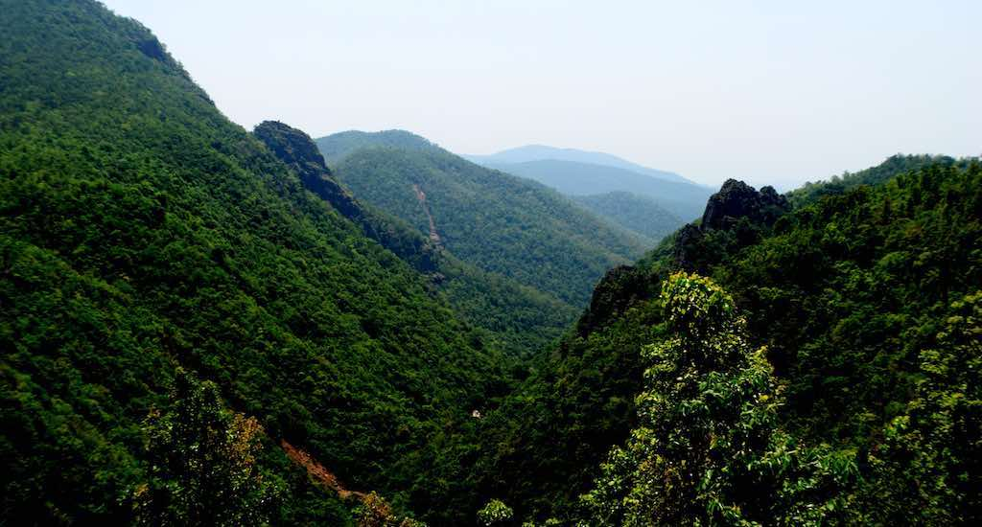
Now if we take a look at the forests and biodiversity of Orissa....
Orissa’s Biodiversity
Orissa ranks fourth amongst State/Union Territories of the country in terms of area under forest cover. The total forest area of the State is 58,135 sq.km. which is 37.34% of the State's geographical area and about 7.66% of country's forests.Orissa host rich biodiversity in variety habitats. The largest Ramsar sites (Brackish water Chilka lake and the mangrove forests of Bhitarkanika), which attract the largest population of migratory birds from very distant
lands, the largest egg laying beaches of Gahirmatha for Olive Ridley Sea turtles, some of India's closed green forests, floral and faunal diversity of Similipal biosphere, rich medicinal plants in Similipal and Gandhamardan forest ranges and many tribal races of people are also found in the state of Orissa.

Slide 21
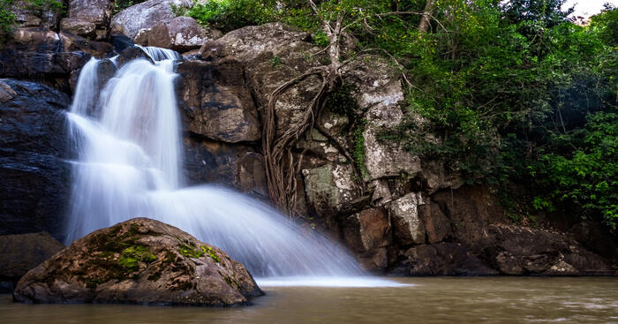
Major biodiversity hotspots in Orissa Similipal Biosphere Reserve:
The uniqueness of Similipal as hot spot of biodiversity lies with the geological formation, phyto sociological feature and climatic situation of the area. The area lies on the northern limit of Deccan plateau and Southern limit of lower gangetic plains adjoining Chhot Nagpur high lands. Similipal, practically is a very large ecotonal zone with an annual rainfall varying from 1200 cm to 2000 cm. The Similipal massif has an average height of about 550 m, the steeper slopes towards southern and east and the gradual sloping terrain towards north and west.
The soil contains volcanic lava which holds large amount of ground water and feeds the waterfalls and river systems. Similipal was a part of Gondwana land in the Paleozoic era and the rocks are Metamorphosed, Sedimentary and Igneous. The unique position of the mountain range acts as a barrier to south west monsoon and brings heavy rain to the area and moisture loaded wind moves to south-west region of the state bringing rain to south western region of Orissa. It is rightly said that, "Similipal to Orissa, part of Bengal and Bihar is as the Himalayas to India".

Slide 22
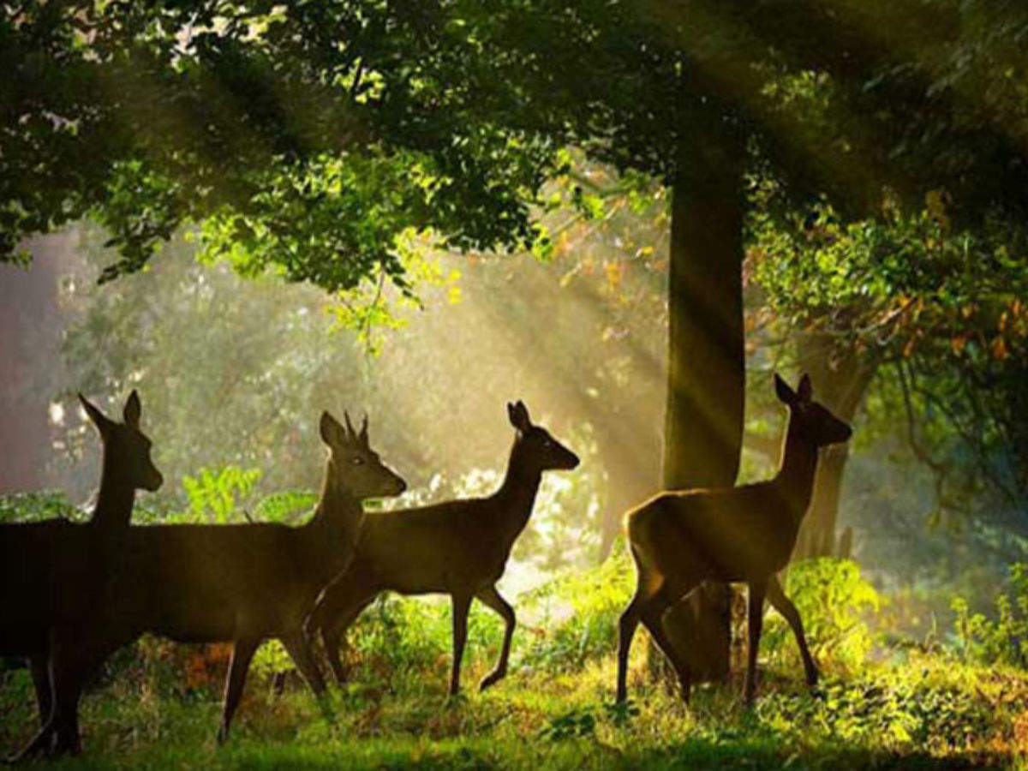
Wildlife in Orissa:
The important wild animals found are the Elephant, Tiger, Panther, Wild buffalo, Wild boar, Bear, Sambar, Spotted Deer, Black buck, Langur, Myna, Parakeet, Hornbill, Woodpeckar, Sea turtles especially Olive Ridleys, Hawksbill Salt water Crocodile, Muggar, Gharial, Python, King cobra, Cobra, Viper, kraits, Chameleon, Monitor lizards, Irrawady Dolphin, Striped dolphin, Bottlenose dolphin, Finless Porpoise, Whale, Whale shark, Horseshoe crabs, Chilika crab, Tiger prawns, Fresh water terrapins, butterflies, spiders etc.

Slide 23
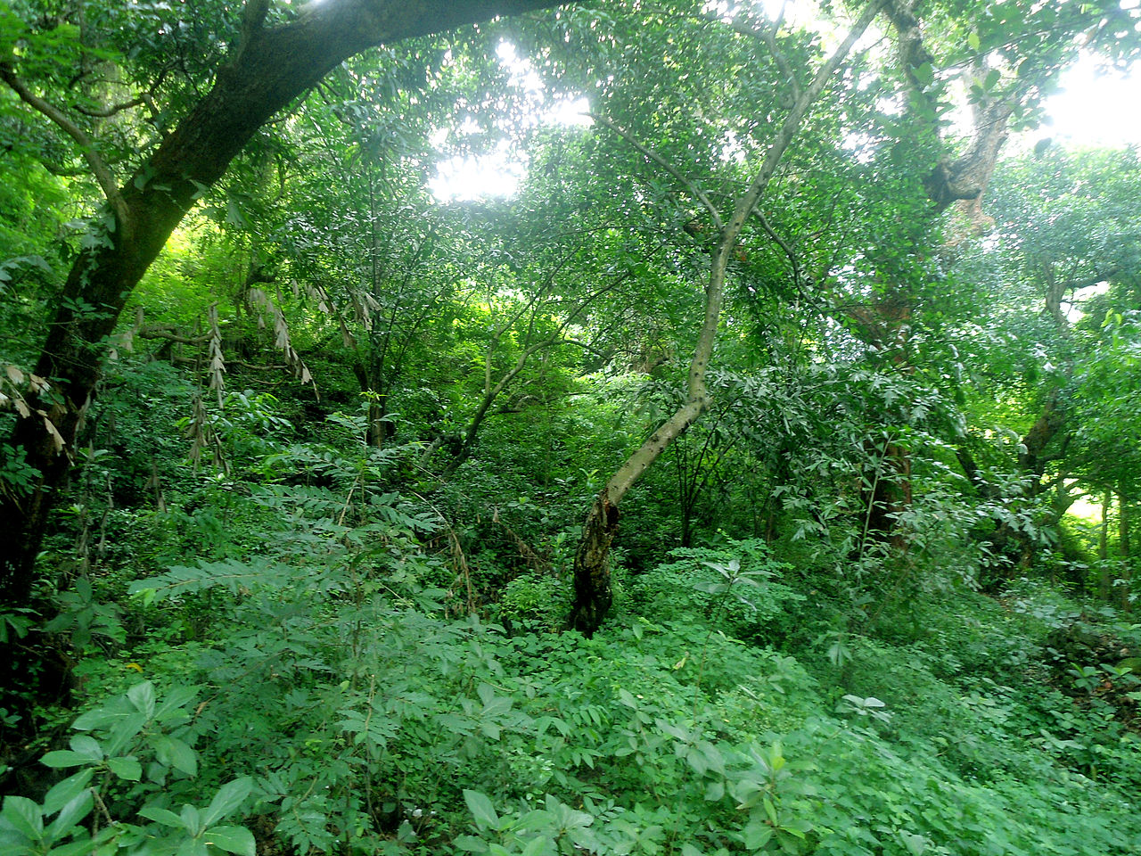
Forests of Orissa
Odisha, one of the 29 States of India, has two basic kinds of forest: in the northeast region of the state the forest is classified as the tropical-moist-deciduous type, blanketing hills, plateaus and other high-altitude isolated areas; in the southwest the tropical-dry-deciduous variety dominate.
Orissa's forests are vast. Out of the total geographical area of 155,707 km², the State records 52,472 km² (~33%) as some version of forest. The actual forest cover may be less, according to the Forest Survey of India, rosewood, sal, piasal, teak and haldi. The forest's naturally vigorous growth accounts for a tremendous wealth of biodiversity, filling many catalogues of the wild plant and animal species dwelling within.
The state has declared large parcels of land as protected areas with the purpose being to allow animals and plants who are sensitive to cohabitation with humans places of relative freedom from interference and habitat loss. These protected areas constitute 10.37% of the total forest area and 4.1% of the total geographical area of the state.

Slide 24
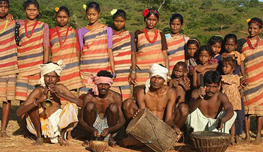
Tribal societies of Orissa…
Despite belonging to different linguistic divisions, the tribes of Odisha (Orissa) have many socio-cultural similarities, and together they characterize the notion of tribalism. Tribal societies share certain common characteristics and by these, they are distinguished from complex or advanced societies. In India, tribal societies have remained outside the main historical current of the civilization for centuries. Therefore, they manifest cultural features signifying a primitive level of socio-cultural existence.
Considering the general features of their eco-system, traditional economy, supernatural beliefs and practices, and recent impacts of modernization, the tribes of Odisha (Orissa) can be classified into six types: hunting, collecting and gathering type, cattle-herder type, simple artisan type, hill and shifting cultivation type, settled agriculture type, and industrial urban worker type. Each type has a distinct style of life which can be best understood in the paradigm of nature, man and spirit complex, that is, on the basis of relationship with nature, fellow men and the supernatural.

Slide 25
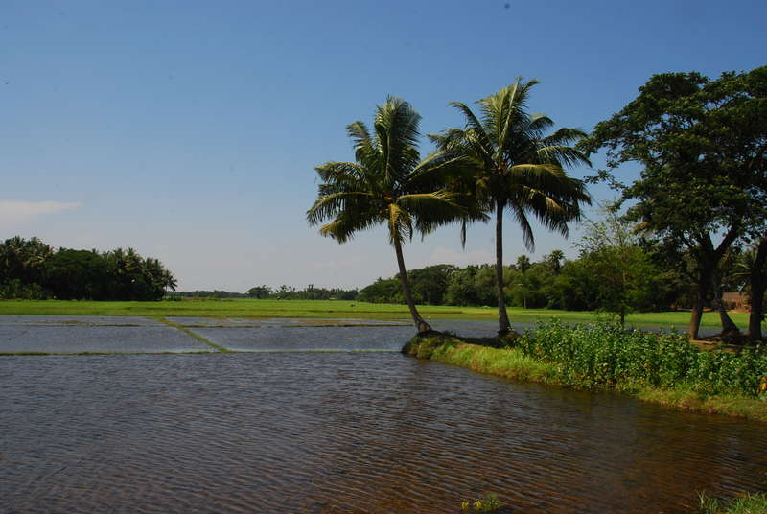
A small traveling tip....
As you journey through plain land or the beautiful mountains and forest ghatroads you'll come across villages of very ornamental, colorful tribal groups. You can visit typical Orissan villages as well as semi-Tribal villages through the beautiful
countryside forest. At Rayagada, you can stay and see the Kutia Kandha tribe or go on to Chatikona to witness the interesting and colorful weekly market of the tribes. Then drive to Jeypore and visit some tribal villages en route and then proceed to witness the most primitive 'Bonda' market.

Slide 26
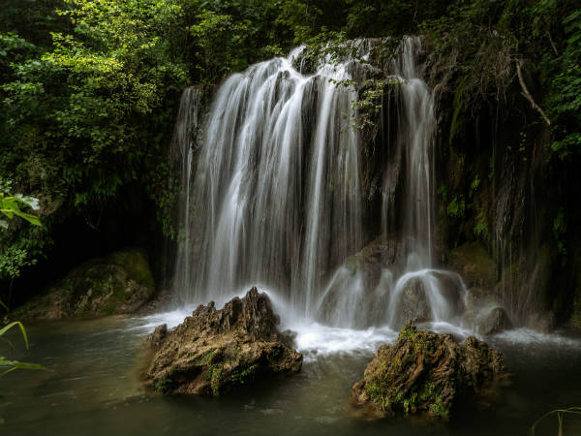
Presentation by-
Shreya Pathak
^{8th F , Roll no. 17}
^{Thank you!}

